Slide 1
Video Communications on the Go
Norman Williams
Senior Research Engineer
Technology Access Program
Gallaudet University
TDI Conference, Albuquerque, NM, October 16-20, 2013

Slide 2
Overview
Who we are
The state of mobile video calling today
Interoperability of videophones
Testing results
Sample of video calls
Battery tests
Idle 6 hours test
10 minutes in call test

Slide 3
Who we are
The Technology Access Program is a deaf-led research center at Gallaudet University
Research areas:
Telecommunications access
Videoconferencing access
9-1-1 access
Hearing aid compatibility of phones
And other technology access issues

Slide 4
Video calling today
Which phone? iPhone or Android i.e. Samsung?
What mobile VRS app do you use for video calls?
nTouch?
ZVRS Z5?
Purple P3?
Convo?
CAAGVRS?
GXPro?

Slide 5
Video calling today
Do you use VRS or mainstream mobile apps for video calls?
VRS app on your mobile
FaceTime
Skype
ooVoo
Tango
Fring
Other?

Slide 6
Video calling today
It is worth remembering what the purpose of VRS and mobile video calls is: Functional equivalence
Can deaf and hard of hearing people use telecommunication services in the same unrestricted manner and at the same costs as hearing people?

Slide 7
Functional Equivalence
Do we have it today?
Do you feel that we have equal access compared to the mainstream?

Slide 8
Interoperability
Interoperability is a big barrier for us in the video calling world.
Interoperability: devices from different vendors and providers work with each other.
See what hearing callers can do:

Slide 9
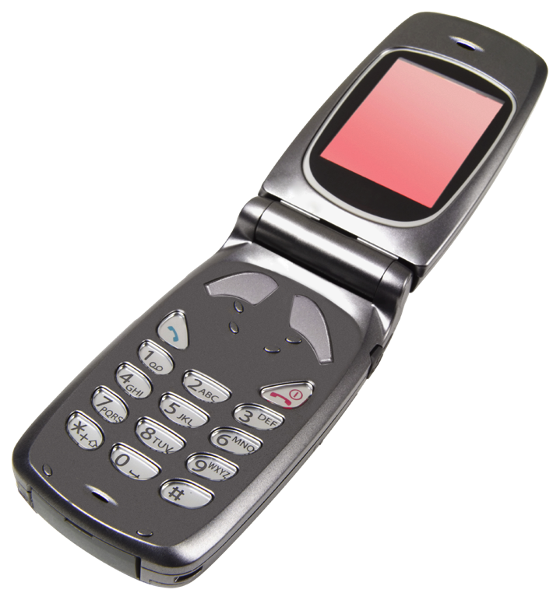
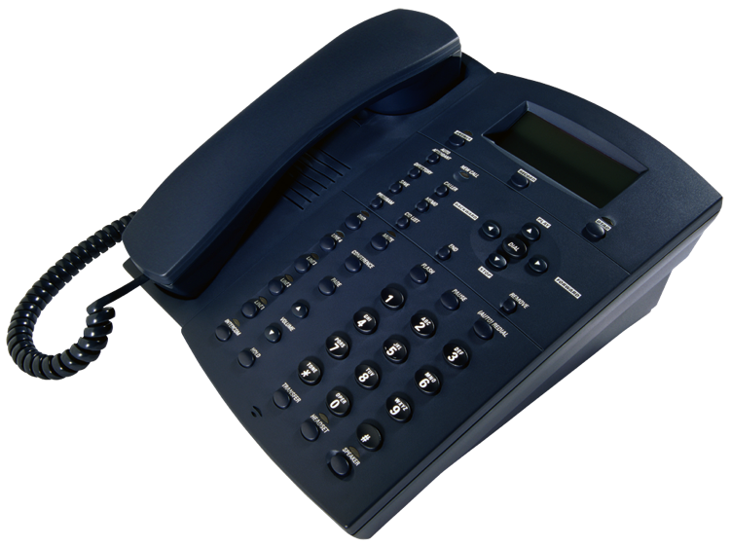
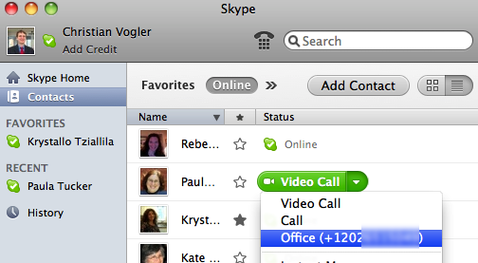
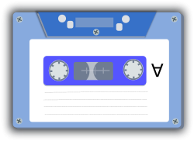
Voice interoperability
Hearing callers can call each other with landline phones, mobile phones, Internet software, and leave messages via answering machines/voicemail. It just works.

Slide 10
Interoperability testing
Tested devices, software and apps from 6 VRS providers: CAAG, Convo, Global VRS, Purple, Sorenson, and ZVRS
Also tested three stand alone devices: Purple’s Smart VP, Sorenson nTouch VP and ZVRS’s Z20 to verify if they can receive mobile calls

Slide 11
Interoperability testing
Last year at the NAD conference, we showed that mobile VRS interoperability was bad.
Has this changed?
We ran tests to find out -

Slide 12
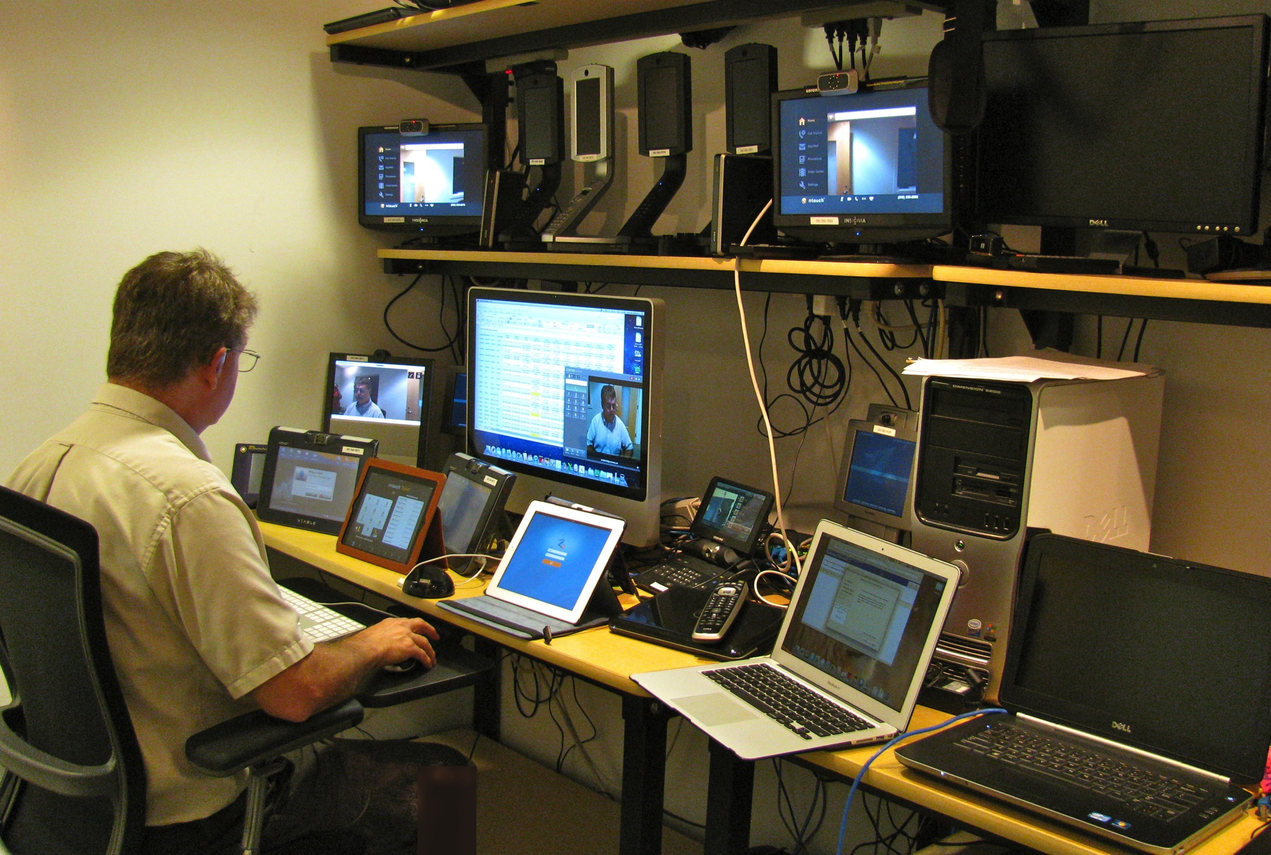
Testing lab

Slide 13
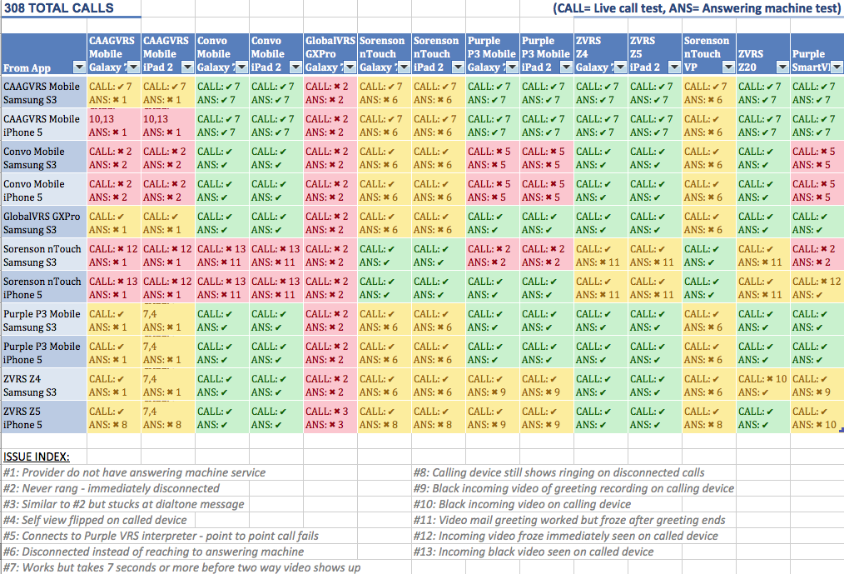
Call Test Matrix

Slide 14
Testing method
Test live call from and to each device/app
Test leaving message on answering machine
Press “reject call” on answering phone to force answering machine on
One limitation: Some phones may behave differently if you just let the call ring – but this would have taken too long for all calls

Slide 15
Testing method
11 x 14 (11 app + 3 VPs) = 308 calls total
All calls use either Wifi or Ethernet. No cellular test calls are used
WiFi tests were done on consumer-grade routers typical of homes for each side of mobile test calls (2 routers)
Each side of call tests uses different Wifi router behind NAT and a different public IP address to simulate real world

Slide 16
Interoperability Issues
Some highlights:
Mobile apps have improved since last year
Live calls work better than leaving messages
Full results on our web site (link is shown on final slide)

Slide 17
Interoperability Issues
Convo:
Calling to any Purple videophone resulted in Purple VRS call instead of point to point calls
Receiving nTouch mobile calls caused black video on Convo side
Convo app making calls to CAAGVRS app did not ring

Slide 18
Interoperability Issues
CAAGVRS:
CAAGVRS iOS app calling to either iOS or Android app of CAAGVRS resulted into black videos
Convo app calling to CAAGVRS apps did not ring
No answering machine offered for CAAGVRS customers
Black video seen on CAAGVRS apps from nTouch app calls

Slide 19
Interoperability Issues
Global VRS:
Can not receive calls in our test accounts but can make calls fine
No answering machine offered for CAAGVRS customers

Slide 20
Interoperability Issues
Purple:
Convo calling to any Purple videophone resulted in Purple VRS call instead of point to point calls
Can't receive nTouch Android calls
ZVRS callers can't see Purple answering machine greetings

Slide 21
Interoperability Issues
Sorenson:
Unable to accept messages on answering machine from non-Sorenson callers
ZVRS answering machine greeting gets stuck on CONNECTING TO ANSWERING MACHINE graphic
Receiving mobile calls from nTouch mobile calls caused black video on Convo
nTouch Android calls can't connect to Purple mobile apps and Purple SmartVP (iOS nTouch worked fine)

Slide 22
Interoperability Issues
ZVRS:
Z4 Android to Z20 resulted black video on Z4 side. Was told Z5 Android will solve this soon.
Black video on ZVRS app/device of Purple answering machine greetings
nTouch calls leaving answering machine on ZVRS will get stuck on "CONNECTING TO ANSWERING MACHINE" graphic
Z5 mobile on iPhone/iPad calls get stuck with RINGING or DIALTONE message on completed calls to providers without answering machine

Slide 23
Types of problems
Videophone does not ring
… you have no idea that someone called
Black/green screen
… the caller can’t see you or vice versa
Poor video
… you can’t do conversation well
Answering machine does not work
… people can’t leave messages for you

Slide 24
Statistics
Success rate of making live calls:
Convo: 16 out of 26
CAAG VRS: 24 out of 26
Global VRS: 13 out of 13
Sorenson: 14 out of 26
Purple: 26 out of 26
ZVRS: 25 out of 26
Note: Calling to Global VRS not counted because of test accounts issues

Slide 25
Statistics
Success rate of receiving live calls:
Convo: 18 out of 22
CAAG VRS: 12 out of 22
Global VRS: 0 out of 11
Sorenson: 33 out of 33
Purple: 23 out of 33
ZVRS: 32 out of 33

Slide 26
Statistics
Success rate of leaving messages on answering machines:
Convo: 10 out of 26
CAAG VRS: 16 out of 26
Global VRS: 8 out of 13
Sorenson: 9 out of 26
Purple: 16 out of 26
ZVRS: 10 out of 26
Note: Calling to Global VRS not counted because of test accounts issues

Slide 27
Statistics
Success rate of taking answering machine messages:
Convo: 18 out of 22
CAAG VRS: does not offer answering machine
Global VRS: does not offer answering machine
Sorenson: 6 out of 33
Purple: 18 out of 33
ZVRS: 27 out of 33

Slide 28
Short Demo
The next slide will have a video playing of selected VRS app calling to either ZVRS’s Z20 or Sorenson’s nVP.
The video will show the quality received from the stand alone VP to the selected VRS app. Not all are the same.
Videos are not sharp as it should be because of a video camera recording off a phone.

Slide 29
Short demo

Slide 30
About mobiles
Interoperability among mobiles has improved since last year
But still is worse than with standalone VPs
Data bandwidth and data caps (2 GB is just 2-4 hours of calling time)
Android support has improved since last year, but still lags months behind iOS
Fragmentation in cameras, screens, and CPUs
At least now most popular phones work

Slide 31
Battery life
Some people think: VRS apps drain your batteries very quickly
That is, you can’t leave them always on.
Is that still true???

Slide 32
Battery Life
We ran two battery life tests in this enviroment:
Strong Wifi signal is used
Killed all running apps except for selected VRS
Bluetooth and mobile data were turned off
Runs on battery only.
Video call tests used a common looping video on a Mac screen
Phone cameras were pointed at it
Two different tests: Idle and in-call.

Slide 33
Idle Battery Life
Idle tests (6 hours) for iPhone 5:
iPhone (No VRS App) 2% drop
iPhone Z5 1% drop
iPhone Purple 2% drop
iPhone CAAG 0% drop
iPhone Sorenson 0% drop
All are about the same of using battery while in good Wifi signal. Cellular use on battery may vary.

Slide 34
Idle Battery Life
Idle tests (6 hours) for Samsung S3:
S3 (No VRS App) 11% drop
S3 Z4 14% drop
S3 Convo 16% drop
S3 Purple 20% drop
S3 CAAG 9% drop
S3 Sorenson 16% drop
There were some Android processes we couldn’t control. Cellular use on battery may vary.

Slide 35
In Call Battery Life
In Call tests (10 minute) for iPhone 5 & iPad 2:
iPhone Convo 7% drop
iPhone Purple 5% drop
iPhone CAAG 6% drop
iPhone Sorenson 5% drop
iPhone Z5 5% drop
iPhone Facetime 6% drop
iPad Facetime 0% drop

Slide 36
In Call Battery Life
In Call tests (10 minutes) for Samsung S3 & Nexus 7 Tablet:
S3 Z4 6% drop
S3 Convo 6% drop
S3 Purple 5% drop
S3 CAAG 6% drop
S3 Sorenson 4% drop
S3 GoogleTalk 6% drop
Nexus 7 Tablet GoogleTalk 3% drop

Slide 37
Battery Life
On iPhones, we saw no difference between leaving the VRS app always on in the background and turning it off.
On Android, VRS apps still eat battery life in the background (but not very much: 6-10% over 6 hours).
We saw no difference between VRS and native apps for battery use during calls
Caution: These were Wifi tests – cellular behavior may be different
Caution: We did not test if the VRS app still was functioning after 6 hours in the background

Slide 38
Battery life tips
To save battery, it is a good idea to kill all applications that are not needed. Use texting to agree for a video one to one calls. Run VRS app for making calls and for expecting video calls.
Both VRS and native video calls (Facetime, Google Hangouts) drain the battery – 30% per hour – or just 2 to 3 hours of calling time on Wifi.
Compare to over 10 hours for voice calls
Is that functionally equivalent?
Fixing battery life during video calls needs to be a priority.

Slide 39
Acknowledgments
The contents of this presentation were developed with funding from the National Institute on Disability and Rehabilitation Research, U.S. Department of Education, grant number H133E090001 (RERC on Telecommunications Access). However, those contents do not necessarily represent the policy of the Department of Education, and you should not assume endorsement by the Federal Government.

Slide 40
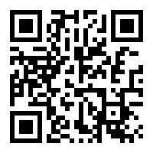
Questions
Questions? Comments?
Supplemental material:
http://tap.gallaudet.edu/Conferences/TDI2013/

